Slide 1
Causal Inference with Graph Neural Networks lecture-13 Course on Graph Neural Networks (Winter Term 20/21)
Christian Medeiros Adriano (christian.adriano@hpi.de) - “Chris”
Sona Ghahremani (sona.ghahremani@hpi.de )
Prof. Dr. Holger Giese (holger.giese@hpi.de)
Notes:
>1- what is the difference between Prediction and Causal Inference? Both are same or diff?
To answer this, I think it is useful to make a distinction between "prediction" and "inference". Both concepts are concerned with mapping observations (inputs, features, covariates) to outcomes (outputs, effects, predictions, states, etc). However, "inference" is more concern with understanding the process that generated the data, while "prediction" focus on having lower error estimates of the outcomes given the observations (inputs).
Causal inference is a particular type of inference that wants to explain the data generation process by means of causal relationships, which implies mitigating three hidden phenomena like confounders, selection bias, latent variables, and covariate shift/concept drift effects from non-stationary variables.
Why one would like to understand the process that generated the data? Besides the fact that a good model of the data geneation process allow to make good predictions, there are two main reasons: (1) robustness to changes in the modeling assumptions and, in case of a causal model, ability to plan intervention that allow to steer (control) the data generation process.
In other words, causal inference allows to (1) produce testable hypotheses about how the phenomenon of interest works and (2) intervene in the phenomenon to improve its behavior (or mitigate its probability of happening and even some of its impacts).
>2- If different, then what direction is best for my future research work? I found many related work of fault localization in Microservice Architecture (MSA) and few articales on Prediction and Causal Inference.
I would definetely choose to work with methods that approximate a data generation process. Causal inference, particularly graph causal inference, is a way of building models based on Bayesian Networks, which build on top of a set of dependency assumptions (Markov properties, Reichenbach principle, etc.). These assumptions allow you express cause-effect relationship that you can test against the data. The tests are based on factorization joint-probability distributions into conditional and marginal probabilities.
The challenge is how to obtain certain conditional and marginal probabilities and also to be able to extrapolate outsite the given data samples. For these, we apply some sort of "generative model". There are simpler ones come from Bayesian Inference, whereas the more sophisticated ones are Gaussian Mixture Models, Latent Dirichlet Allocation, Auto-Regressive Models, Hidden Markov Models, and Variational Autoencoders.
The choice of generative model depends on the assumptions that you make about the data that you have, for instance, continuous versus discrete data, normally distributed, IID, existence of strong or weak previous knowledge (priors), temporal (non-stationary) or not, etc. However, many models are equivalent, which is nice, because you can apply them and compare their outcomes.

Slide 2
Quick recap – Where are we now?
Graph Metrics and Random Models
Graph Classification - Clustering
Graph Sampling - Random Walks
Graph Embeddings - Message Passing
PageRank
Graph Structure Learning
Graph Convolutional Networks
Graph Attention Networks
Graph Evolution Networks
Temporal Graph Networks
Graph Neural Differential Equations
Deep Graph Generative Models
Causal Graph Neural Networks
Propagation Graph Neural Networks
Network Effects, Cascading and Contagion
Outbreak Detection and Influence Maximization
Design concerns
Understand a phenomenon
Extract features
Stablish baselines
Preprocessing data
Description models
Predict an outcome
ML architecture and pipeline
Training models
Evaluation models
Prediction models
Effects of interventions
Risks of confounding
Causal structure
Intervention models

Slide 3
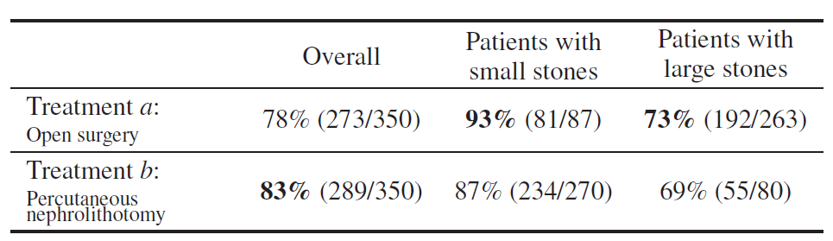
Simpsom Paradox
Definition: this paradox happens when a statistic holds for the entire population, but reverses at each subpopulation
more
more
Source: [Peters et al. 2017] [Bottou et al., 2013, Charig et al., 1986, tables I and II]

Slide 4
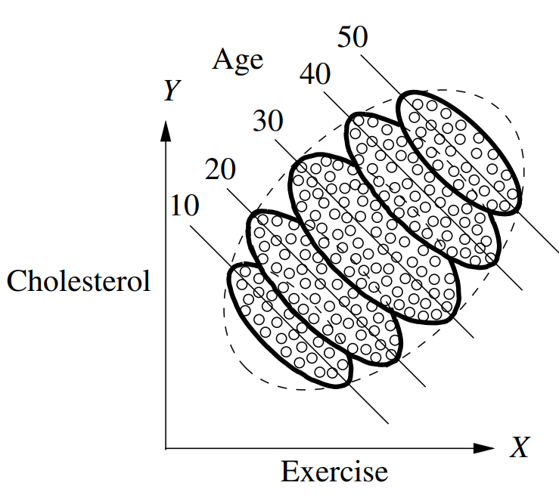
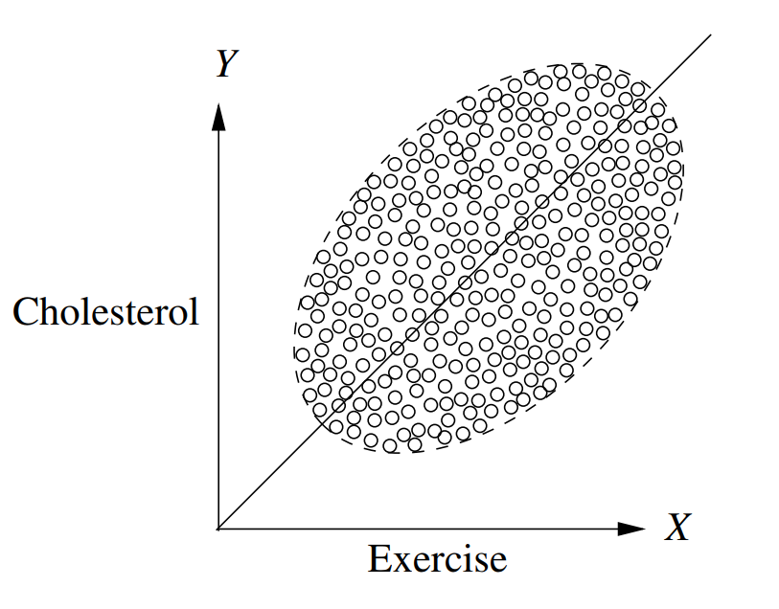
Simpsom Paradox - 2
Source: Pearl, Glymour & Jewell, Causal Inference in Statistics: A Primer, 2016
Age
Solution – condition on age!
Exercise
Cholesterol
Notes:
Another good example is the length of comments on Reddit.
Barbosa, S., Cosley, D., Sharma, A., & Cesar Jr, R. M. (2016, April). Averaging gone wrong: Using time-aware analyses to better understand behavior. In Proceedings of the 25th International Conference on World Wide Web (pp. 829-841). International World Wide Web Conferences Steering Committee.

Slide 5
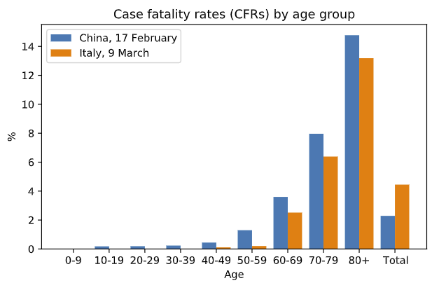
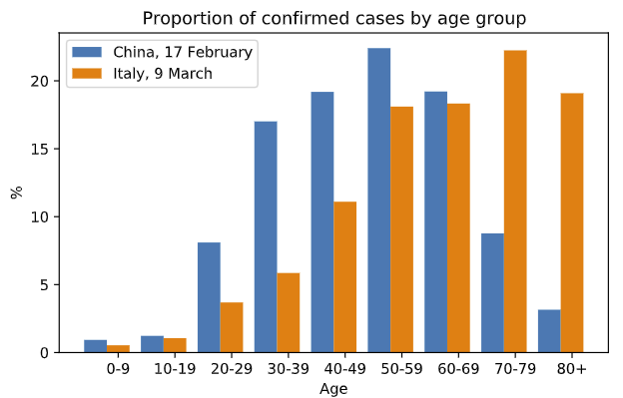
Covid-19 fatality rates China and Italy
Because Italy has a larger proportion of confirmed cases among older age groups.
CFR(China) < CFR(Italy) !
Solution – condition on additional factors = Age
Sources: [Schölkopf et al. 2020] [Wu & McGoogan 2020] [Instituto Superiore di Sanita 2020]
Notes:
how can the disease in Italy be less fatal for the young, less fatal for the old, but more fatal for
the people overall?
[Schölkopf et al. 2020] von Kügelgen, J., Gresele, L., & Schölkopf, B. (2020). Simpson's paradox in Covid-19 case fatality rates: a mediation analysis of age-related causal effects. arXiv preprint arXiv:2005.07180.
[Wu & McGoogan 2020] Zunyou Wu and Jennifer M McGoogan. Characteristics of and important lessons from the
coronavirus disease 2019 (COVID-19) outbreak in China: summary of a report of 72 314
cases from the Chinese Center for Disease Control and Prevention.
Jama, 2020.
[Instituto Superiore di Sanita 2020] Instituto Superiore di Sanita. Epidemia COVID-19: Aggiornamento nazionale, 09 Marzo 2020 – ore 16:00. https://www.epicentro.iss.it/coronavirus/bollettino/Bollettino-sorveglianza-integrata-COVID-19_09-marzo-2020.pdf
, 2020
Quote from [Scholkoepf et al. 2020] “How can such a pattern be explained? The key to understanding the phenomenon lies in the fact
that we are dealing with relative frequencies: the CFRs shown in percent in Fig. 1a are ratios and
correspond to the conditional probabilities of fatality given a case from a particular age group and
country. However, such percentages conceal the absolute numbers of cases within each age group.”

Slide 6
When to condition? Confounding graph patterns
Fork
Skill
Pipe
Difficulty
Duration
Accuracy
Difficulty
Accuracy
Collider
Descendant
Difficulty
Explanation size
Explanation size
Duration
Skill
Duration
Accuracy
Accuracy

Slide 7

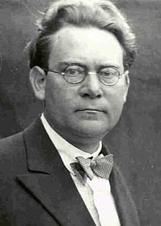
Reichenbach’s Common Cause Principle
Hans Reichenbach 1891-1953
Assume that X Y (X and Y are dependent)
X causes Y
Y causes X
There is a third hidden common cause*
Combination all the above
In other words, “there is not correlation without causation”
*Also called spurious correlation between X and Y. Spurious correlations are not stable properties that hold across environments [Woodward 2005], hence invariance can be used to discover the causal structure [Arjovsky et al. 2019].
[Woodward 2005] Making things happen: A theory of causal explanation. Oxford university press.
[Arjovsky et al. 2019] Invariant risk minimization. arXiv preprint arXiv:1907.02893.
Notes:
Latex code for the independence symbol - https://tex.stackexchange.com/questions/218631/symbol-for-not-conditionally-independent
James Woodward. Making things happen: A theory of causal explanation.Oxford university press, 2005.

Slide 8
How to deconfound?
Condition on the parents (close backdoor paths)
Adjustment formula
parents of X, e.g., programmer skill, complexity of code, buggy/not buggy
outcome, e.g., True Positive
$$P\left(Y=y \right| do\left(X=x\right)= \sum_{z}{P\left(Y=y \right| X=x, Z=z) P\left(Z=z\right) }$$
difficulty low (0) or high (1)
$$P\left(Y=y \right| do\left(X=x\right)= \sum_{z}{\frac{P(Y=y, X=x, Z=z)}{P(X=x, Z=z)} }$$
Propensity Score

Slide 9
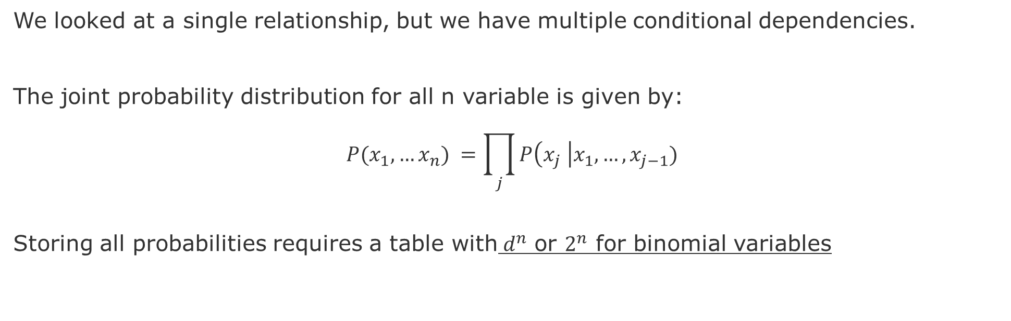
From Single to Multiple Relationships
We looked at a single relationship, but we have multiple conditional dependencies.
The joint probability distribution for all n variable is given by:
$$P(x_{1},…x_{n}) =\prod_{j}{P\left(x_{j} \right|x_{1},…,x_{j−1})}$$
Storing all probabilities requires a table with${ d}^{n}$ or $2^{n}$ for binomial variables
Hence, the exhaustive exploration of all DAGs with n variables is super-exponential in n, hindering the effectivity of brute-force methods for observational causal discovery even for moderate n.
Notes:
Still exponential in the number of parents, but we do not expect too many parents. The reason being that we do not expect that everything is conditional on everything.

Slide 10
Brute force search does not scale
7 nodes = 4 million graphs
8 nodes = 800 billion graphs
9 nodes = 1,548 times more
(or 1.2 10^16 graphs)
source: [Sloane 2019]
Notes:
Hence, we need to be able to refine a graph model, for that we need a set of operations and properties so we can test hypotheses about graph dependencies and independencies
[Sloane 2019] N. J. A. Sloane, Number of acyclic digraphs (or DAGs) with n labeled nodes, in The Online Encyclopedia of Integer Sequences, available at http://oeis.org/A003024/b003024.txt (accessed May 2019)
However, nodes can be arranged in many different. Three nodes can be arranged in 25 different acyclic graphs (DAG), 4 nodes can compose 543, and 5 nodes 29281 DAGs, 6 nodes 3781503, and 7 to 1138779265 DAG. Yes, but how to know which is the correct mechanism?
7 nodes = 4 million graphs
8 nodes = 800 billion graphs
9 nodes = 1,548 times more (or 1.2 10^16 graphs)

Slide 11
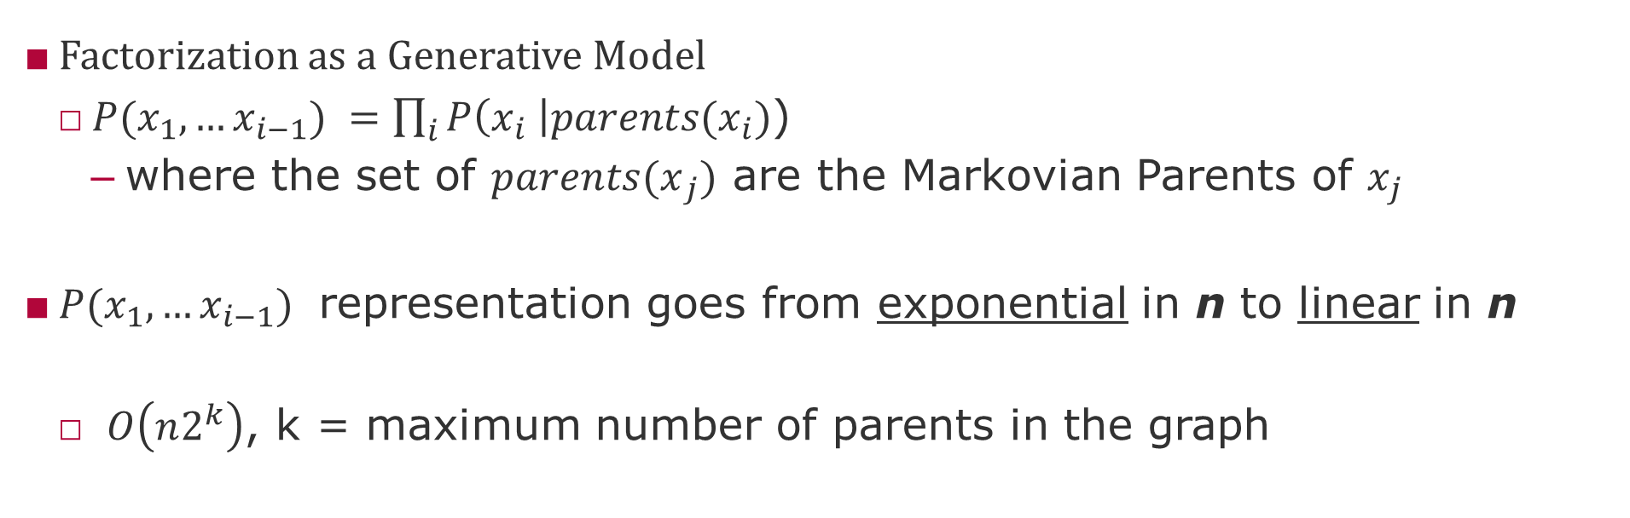
Markovian parents?
Factorization as a Generative Model
$P(x_{1},…x_{i−1}) =\prod_{i}{P\left(x_{i} \right|{parents(x}_{i})}$)
where the set of ${parents(x}_{j})$ are the Markovian Parents of $x_{j}$
$P(x_{1},…x_{i−1})$ representation goes from exponential in n to linear in n
$O\left(n2^{k}\right)$, k = maximum number of parents in the graph
However, this still requires two strong assumptions:
Known structure of the graph (parent-child relationships) and
Small maximum number of parents of any given node.
Notes:
Still exponential in the number of parents, but we do not expect too many parents. The reason being that we do not expect that everything is conditional on everything.
However, we can save space if we know that variables depend on a small set of other variables. Dependency structure allows to decompose large distribution functions into smaller ones that can latter on be combined. A dependency structure is a graph.

Slide 12
Independent Causal Mechanisms (ICM) Principle
“The causal generative process of a system’s variables is composed of autonomous modules that do not inform or influence each other.
In the probabilistic case, this means that the conditional distribution of each variable given its causes (i.e., its mechanism) does not inform or influence the other mechanisms.”
Schölkopf, B. (2019). Causality for machine learning. arXiv preprint arXiv:1911.10500.
Notes:
This principle subsumes several notions important to causality, including separate intervenability of causal variables,
modularity and autonomy of subsystems, and invariance (Pearl, 2009a; Peters et al., 2017). If we have only two variables,
it reduces to an independence between the cause distribution and the mechanism producing the effect distribution.

Slide 13
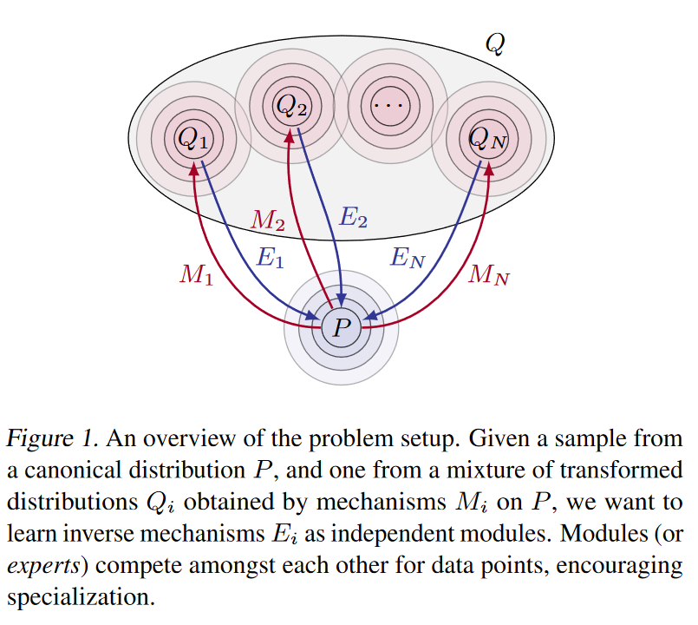
Locality of Mechanisms [Parascandolo et al. 2018]
Knowledge can be decomposed in modules and mechanisms that are independent
Mechanisms can only be discovered by interventions, i.e., acting in the world
Mechanisms can be reuse across subdomains
Interventions usually affect only one mechanism at a time
There is only one causal graph that reflects the true causal mechanisms
source: Parascandolo, G., et al., (2018) Learning Independent Causal Mechanisms, PMLR 80.

Slide 14
Statistical Inference

Slide 15
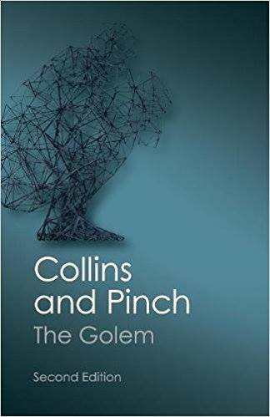
Statistical Modeling- Fundamental challenge
Math & Engineering
The Golem of Prague
Characteristics
Animated by “truth”
Powerful
Ignorant to engineer's “intent”
Easy to misuse
Fictional / Always false

Slide 16
Statistical Modeling- hypotheses and models
Hypothesis
Process Model
Statistical Model
Process-A
H0
Model-X
Process-B
Model-Y
Process-C
H1
Model-Z
Process-D

Slide 17

Statistical Modeling- different processes same model
https://www.autodeskresearch.com/publications/samestats

Slide 18
Statistical Modeling - falsifiability
Hypothesis must be falsifiable
Process or model that can negate the hypothesis
However
Hypothesis are not models
Measurement error
Latent variables
modus tollens
Denying the consequence
“If A then B, if not B then not A”
What we cannot know because it does not exist – Sean Carrol

Slide 19
Statistical Modeling - plausibility
Ockham Razor
Highest rate of predictions by assumptions
Fewest assumptions for the same predictions
Metrics
Error
Variance
Correlation
Area under the curve
Risk of Overfitting
Out of Distribution (OOD) Error
WAIC, Pareto Smooth Cross-Validation

Slide 20
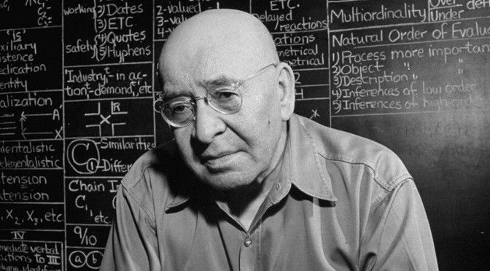
Towards Causal Mechanisms
“A map is not the territory it represents, but, if correct, it has a similar structure to the territory, which accounts for its usefulness.”
― Alfred Korzybski, Science and Sanity: An Introduction to Non-Aristotelian Systems and General Semantics
Notes:
“If words are not things, or maps are not the actual territory, then, obviously, the only possible link between the objective world and the linguistic world is found in structure, and structure alone.”

Slide 21
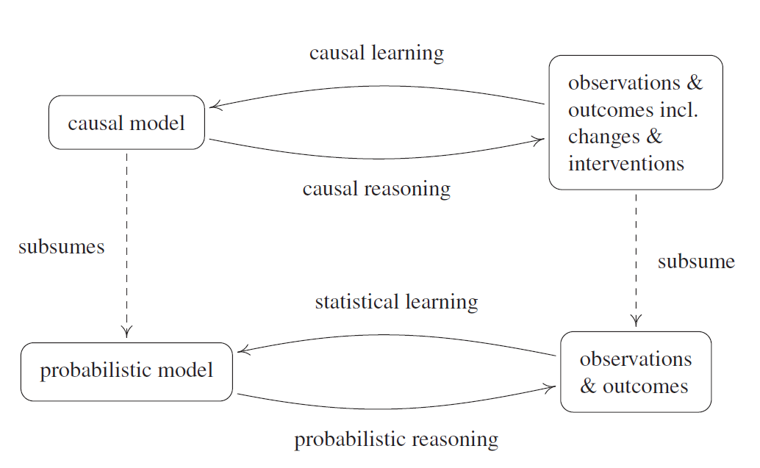
Overall approach to causal inference
source: Peters, J., Janzing, D., & Schölkopf, B. (2017). Elements of Causal Inference: Foundations and Learning Algorithms. MIT Press.
Notes:
@book{peters2017elements, title={Elements of Causal Inference: Foundations and Learning Algorithms}, author={Peters, Jonas and Janzing, Dominik and Sch{\"o}lkopf, Bernhard}, year={2017}, publisher={MIT Press} }

Slide 22
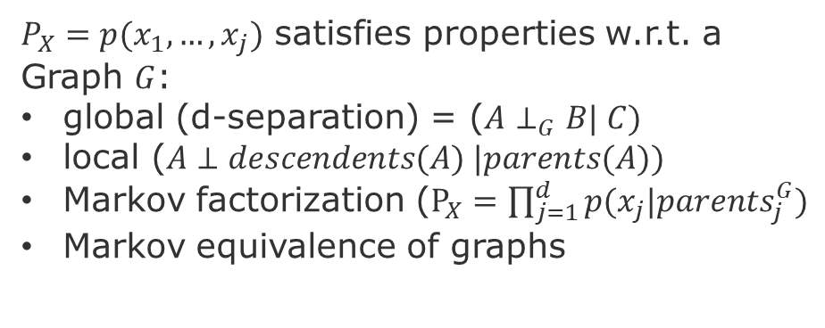
Index of Causal Inference Methodology
Methods
Fundamental problem of causality
Confounding
Reichenbach’s principle
Potential outcome
No causation without intervention
Motivation
Ignorability (no confounders)
Positivity (no imbalances)
Modularity (stable unit of treatment)
Consistency (compliance)
Exclusiveness (effective intervention)
Causal discovery
Matching
Adjustments (backdoor criterion)
Hypothetical interventions (do-operator)
Instrumental Variables
Assumptions
$P_{X}=p(x_{1},…,x_{j})$ satisfies properties w.r.t. a Graph $G$:
global (d-separation) = ($A⊥_{G}B| C)$
local ($A⊥descendents(A) |parents(A))$
Markov factorization ($P_{X}=\prod_{j=1}^{d}{p(x_{j}|p{arents}_{j}^{G}})$
Markov equivalence of graphs
Models
Graph-based
Potential outcome-based
Average Treatment Effect (ATE)
Conditional ATE (CATE)
AT on the Treated (ATT)
Local ATE (LATE)
Notes:
Local property can be test

Slide 23
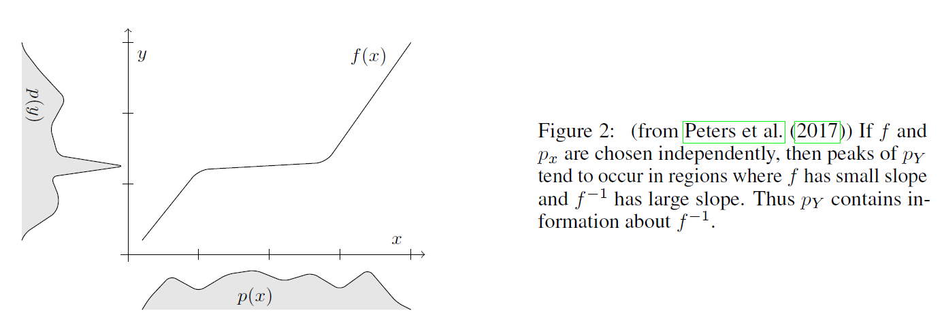
Intervention
Intuition: Interventions allow to maximize mutual information between:
1- intentions (goal-conditioned policies) AND
2- changes in state (trajectories) condition on the current state
Measures of dependence of mechanisms
Peters, D. Janzing, and B. Schölkopf. 2017. Elements of Causal Inference - Foundations and Learning Algorithms. MIT Press, Cambridge, MA, USA.
Schölkopf, B. (2019). Causality for machine learning. arXiv preprint arXiv:1911.10500.

Slide 24
Intervention Examples
What should I do in the system to change Y?
What treatment should I take to attain a certain level of change on Y?
e.g., increase programmer skill to improve code inspection accuracy?
Should recruit graduate student with minimum four years of experience OR
Give programmers the double of the time to finish a task?
Ask programmers to give a second or third look at the same source code?

Slide 25
Counterfactual
What would have been the outcome Y if the covariate X had a different value?
e.g., would this programmer have been more accurate if she:
Has spent more time?
Had see the source code for a second and third time?
Hence, has had the chance to increase confident?
Has written a longer explanation?

Slide 26
Modularity of interventions
Definition:
modularity of the interventions consists of two assumptions:
the intervention on node X affects only the structural assignments of X
how the intervention is executed does not influence the results of the intervention
pg. 125 in [Peters, Janzing, & Schölkopf 2017]
Intuition:
We can set and unset variable values without altering the structure of the functions that relate the variables with each other.
Notes:
[Peters, Janzing, & Schölkopf 2017] Peters, J., Janzing, D., & Schölkopf, B. (2017). Elements of causal inference: foundations and learning algorithms. MIT press.

Slide 27
Stability condition
Definition: As we vary the parameters of a causal model (e.g., regression coefficients), no independences in the probability model can be destroyed.
[Pearl 2009]
Intuition:
Causal relationships are more stable than probabilistic relationships, because we assume that
Causal relationships = objective physical constraints in our world (ontological)
Probabilistic relationships = belief or knowledge about the world (epistemic)
Notes:
See page 49 of [Pearl 2009] for an example of how to violate this condition by having unstable dependencies.

Slide 28
Ignorability
Definition:
It is possible to identify or estimate an unbiased result from data that was originated from selection bias, if the following holds:
Y(X) is conditionally independent of X|Z
Intuition:
Conditioning on Z takes away the variation of the individual. This means that the treated (A=1) and the control (A=0) are equivalent in terms the distribution of their covariates.
Notes:
Ignorability (or exchangeability) means that treated (A=1) and control (A=0) are equivalent in terms the distribution of their covariates. Positivity means that propensity score is between zero and one (excluding), but not zero or one. Formal definition ignorability

Slide 29
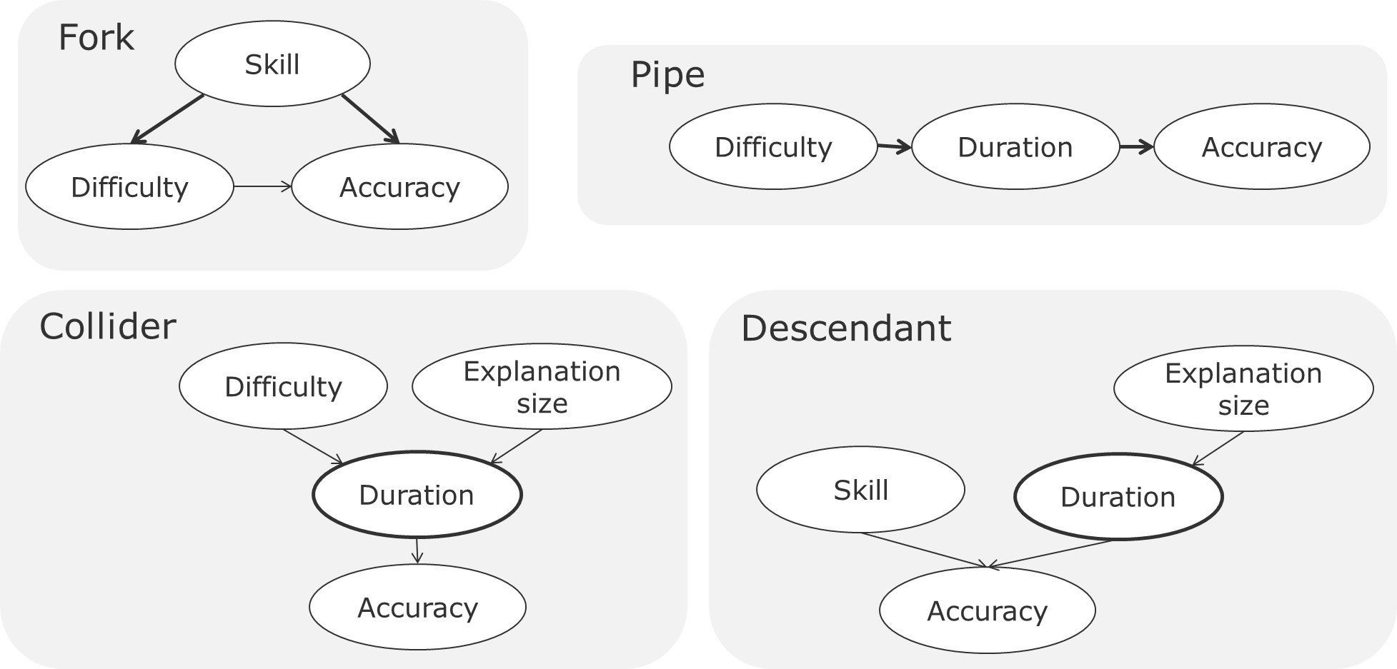
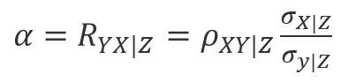
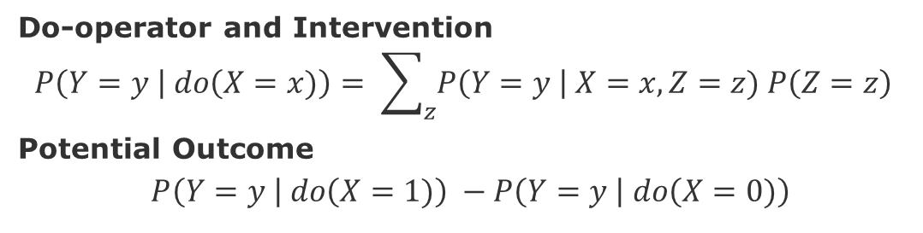
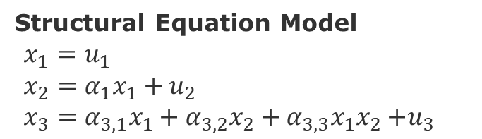
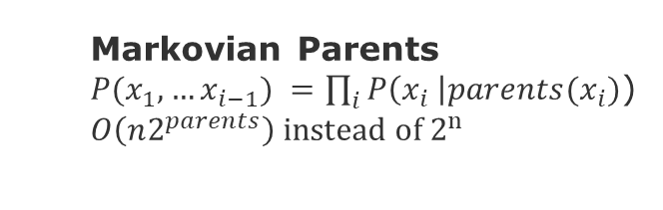
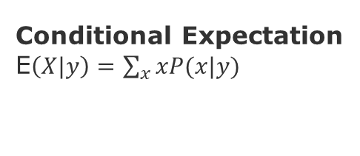
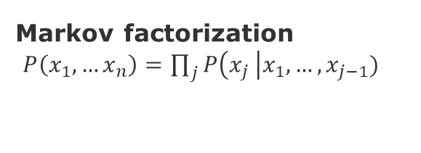
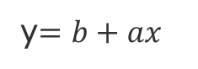
Overall approach to causal inference methods
Graph patterns
Do-operator and Intervention
$$P\left(Y=y \right| do\left(X=x)\right)= \sum_{z}{P\left(Y=y \right| X=x, Z=z) P\left(Z=z\right) }$$
Potential Outcome
$$P\left(Y=y \right| do\left(X=1)\right) −P\left(Y=y \right| do\left(X=0)\right)$$
Markov factorization
$P\left(x_{1},…x_{n}\right)=\prod_{j}{P\left(x_{j} \right|x_{1},…,x_{j−1})}$
Causal Inference Assumptions:
Ignorability (no confounders)
Positivity (no imbalances)
Modularity (stable unit of treatment)
Consistency (compliance)
Exclusiveness (effective intervention)
Markovian Parents
$P(x_{1},…x_{i−1}) =\prod_{i}{P\left(x_{i} \right|{parents(x}_{i})}$)
$O\left(n2^{parents}\right) instead of 2^{n}$
Conditional Expectation
E$\left(X|y\right)=\sum_{x}{xP(x|y)}$
Regression
Structural Equation Model
$x_{1}=u_{1}$
$x_{2}=α_{1}x_{1}+u_{2}$
$x_{3}=α_{3,1}x_{1}+α_{3,2}x_{2}+α_{3,3}x_{1}x_{2}{+u}_{3}$
y$=b+ax$
${α=R}_{YX|Z}$ $=ρ_{XY|Z}\frac{σ_{X|Z}}{σ_{y|Z}}$
[Peters, Janzing, & Schölkopf 2017] Elements of Causal Inference: Foundations and Learning Algorithms. MIT Press.
Notes:
@book{peters2017elements, title={Elements of Causal Inference: Foundations and Learning Algorithms}, author={Peters, Jonas and Janzing, Dominik and Sch{\"o}lkopf, Bernhard}, year={2017}, publisher={MIT Press} }
Ignorability = Given the background variable, X, treatment assignment W is independent to the potential outcome
Positivity = For any value of X, treatment assignment is not deterministic
Modularity (Stable Unit Treatment Value Assumption SUTVA) = The potential outcomes for any unit
do not vary with the treatment assigned to other units, and, for each unit, there are no different forms or versions of
each treatment level, which lead to different potential outcomes.

Slide 30
Fundamental Concepts

Slide 31
Bayesian Networks
Definition: A Bayesian Network (BN) is a Directed Acyclic Graph (DAG) where nodes are propositional variables and edges are local dependencies between conceptual related propositions.
Intuition: Nodes are variables and edges are conditional probabilities.
P(Z)
Z
P(X|Z)
P(Y|Z)
X
Y
P(Y)
P(X)
P(Y|X)

Slide 32
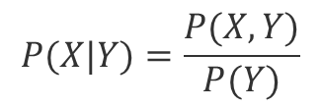
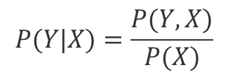
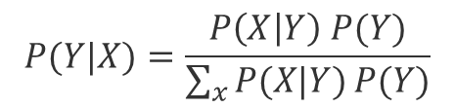
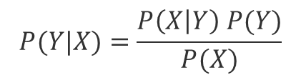
Recap - Conditional probability and Bayes Theorem
$$P(Y|X)=\frac{P(Y,X)}{P(X)}$$
P(Z)
(1)
Z
$$P(X|Y)=\frac{P(X,Y)}{P(Y)}$$
P(X|Z)
P(Y|Z)
(2)
X
Y
$$P(Y|X)=\frac{P\left(X | Y\right) P(Y)}{P(X)}$$
P(Y)
(3)
(Bayes Theorem)
P(X)
P(Y|X)
$$P(Y|X)=\frac{P\left(X | Y\right) P(Y)}{\sum_{x}{P(X|Y)}P(Y)}$$
(4)

Slide 33
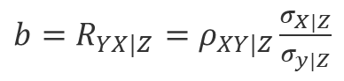
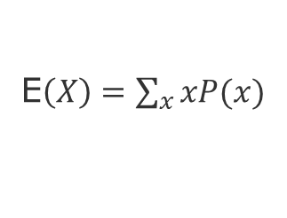
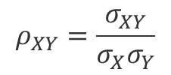
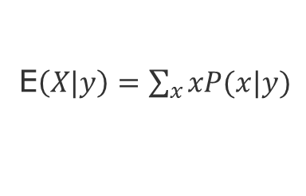
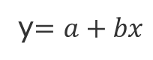
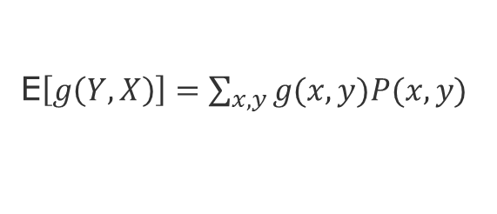
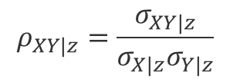
Recap - Conditional Correlation and Regression
P(Z)
(Mean)
E$\left(X\right)=\sum_{x}{xP(x)}$
Z
P(X|Z)
P(Y|Z)
(Conditional Mean)
E$\left(X|y\right)=\sum_{x}{xP(x|y)}$
X
Y
(Expectation of a function)
E$\left[g\left(Y,X\right)\right]=\sum_{x,y}{g(x,y)P(x,y)}$
P(Y)
P(X)
P(Y|X)
(Covariance)
$$g\left(Y,X\right)=σ_{XY}= E[ (X−E(X)) . (Y – E(Y)) ]$$
(Regression)
(Correlation)
$$ρ_{XY}=\frac{σ_{XY}}{σ_{X}σ_{Y}}$$
y$=a+bx$
$$ρ_{XY|z}=\frac{σ_{XY|z}}{σ_{X|z}σ_{Y|z}}$$
${b=R}_{YX|Z}$ $=ρ_{XY|Z}\frac{σ_{X|Z}}{σ_{y|Z}}$
(Conditional Correlation)

Slide 34
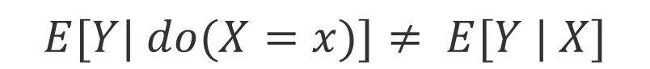
Interventional Expectation – do Operator
$$E[Y| do(X=x)]≠ E[Y | X]$$
Because of the unobserved confounders!

Slide 35
Identifiability
Can I predict the outcome of an intervention?
A causal quantity is identifiable if it can be written as a function of the observed variables.
In other words. If I observe an infinite amount of data from my processes can I make a prediction under intervention?
Can I use the observable joint distribution to make a prediction about some other joint distribution (which is the one that I intervened)?
Notes:
From https://www.youtube.com/watch?v=vKK_1GvaG0Y

Slide 36
From Bayesian Network Methods to Robust ML
Scalability & Stability
Markov Factorization
Reichenbach’s Common Cause Principle
d-Separation
Markov-Blanket
Causal Markov Condition
do-Operator
Back-door criteria
Adjustment
Modularity
Ignorability
Notes:
Important to identify structural properties
(Scalability, Stability of causal relations and independence of random terms)

Slide 37
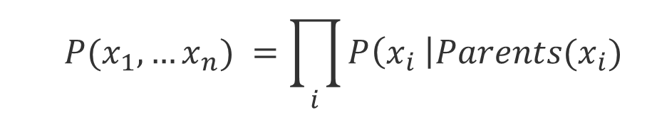
Markov factorization
$$P(x_{1},…x_{n}) =\prod_{i}{P\left(x_{i} \right|{Parents(x}_{i})}$$
Causal Markov kernels
If P admits the factorization relative to a DAG G, we can say that the DAG represents the probability function P, i.e., G and P are compatible or that P is Markov relative to G.
We can also say that the Graph G induces the probability P.

Slide 38
d-separation
X and Y are d-separated if all paths between X and Y are blocked by a set Z of nodes,
i.e., X ꓕ Y | Z
The blocking* situations are:
X
Z
Y
Pipe
X
Z
Y
Blocked only if conditioned on Z
X
Z
Y
Fork
X
Z
Y
Already blocked without conditioning on Z
Collider
*grey means blocked (usually by conditioning on it)
Notes:
Colliders, or Immoralities or v-structures

Slide 39
Consequences of d-Separation

Slide 40
Causal Markov Condition
Definition:
P is Markov w.r.t. G for all Z, if X is d-separated of Y given Z, i.e., X ꓕ Y | Z [Peters, Janzing & Schölkopf 2017]
Hence, for all distinct variables X and Y in G ,if X does not cause Y, then
P(X | Y , Parents(X)) == P(X | Parents(X)) [Hausman & Woodward 1999]
Intuition:
Conditional on its parents, X is independent of every variable in G except its effects [Spirtes, Glymour & Scheines 1993]
Notes:
Causal Markov Condition relates statements about graph separation to conditional independences.
Note however, that different graphs can encode the same conditional independences.
https://en.wikipedia.org/wiki/Causal_Markov_condition
[Peters, Janzing & Schölkopf 2017] Peters, J., Janzing, D., & Schölkopf, B. (2017). Elements of causal inference: foundations and learning algorithms. MIT press.
[Hausman & Woodward 1999] Hausman, D. M., & Woodward, J. (1999). Independence, invariance and the causal Markov condition. The British journal for the philosophy of science, 50(4), 521-583.
[Spirtes, Glymour & Scheines 1993] Spirtes, Peter, Glymour, Clark and Scheines, Richard [1993]:Causation, Prediction,and Search,New York: Springer-Verlag.

Slide 41
Markov Blanket [Pearl 1988]
Definition: A Markov Blanket of X consists of all Parents(X), Descendants(X), and Co-Parents(X)
Intuition: A node is conditionally independent of the entire network, given its Markov blanket.
Notes:
Causal Markov Condition relates statements about graph separation to conditional independences.
Note however, that different graphs can encode the same conditional independences.
https://en.wikipedia.org/wiki/Causal_Markov_condition
[Hausman & Woodward 1999] Hausman, D. M., & Woodward, J. (1999). Independence, invariance and the causal Markov condition. The British journal for the philosophy of science, 50(4), 521-583.

Slide 42
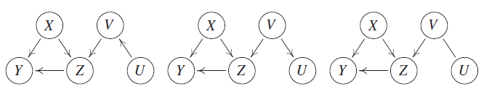
Markov equivalence classes
Graphs are equivalent if they have the same set of nodes and present the same colliders.
source: [Peters, Janzing & Schölkopf 2017]
Notes:
Causal Markov Condition relates statements about graph separation to conditional independences.
Note however, that different graphs can encode the same conditional independences.
https://en.wikipedia.org/wiki/Causal_Markov_condition
[Peters, Janzing & Schölkopf 2017] Peters, J., Janzing, D., & Schölkopf, B. (2017). Elements of causal inference: foundations and learning algorithms. MIT press.
[Hausman & Woodward 1999] Hausman, D. M., & Woodward, J. (1999). Independence, invariance and the causal Markov condition. The British journal for the philosophy of science, 50(4), 521-583.

Slide 43
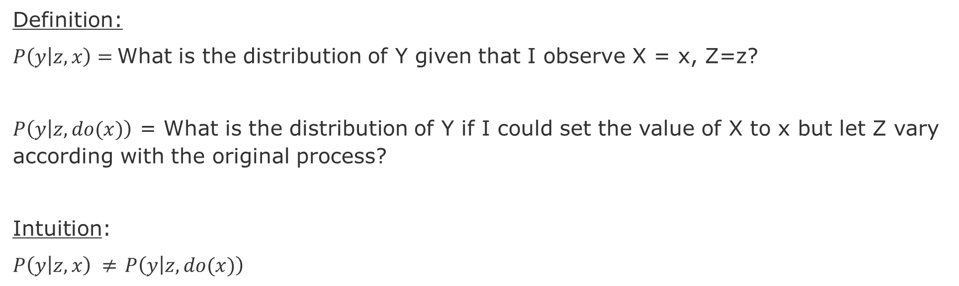
do-Operator
Definition:
$P\left(y | z,x\right)=$What is the distribution of Y given that I observe X = x, Z=z?
$P\left(y | z,do(x)\right)$ = What is the distribution of Y if I could set the value of X to x but let Z vary according with the original process?
Intuition:
$P\left(y | z,x\right) ≠$ $P\left(y | z,do(x)\right)$
(Original)
(After intervention)
Z
Z
P(X|Z)
P(Y|Z)
P(Y|Z)
X
Y
X
Y

Slide 44
Back-door criterion
Definition: A set of variables Z satisfies the back-door criteion relative to X,Y if no node in Z is a descendant of X, and Z blocks every path between X and Y that contains an arrow into X.
Then the causal effect of X on Y is given by:
$$P\left(Y=y \right| do\left(X=x\right)= \sum_{z}{P\left(Y=y \right| X=x, Z=z) P\left(Z=z\right) }$$

Slide 45
Back-door criterion - Intuition
Intution:
We want to block back-door paths because they make X and Y dependent.
However, we do not want to block any descendants of X because they might mediate causal effect from X to Y.
We do not want to create spurious paths, e.g., by conditioning on a colliders that creates a spurious dependency between and X and Y.
Since these dependencies are not causal, they are confounders.
Back-door criterion enables to attain the ignorability condition, hence mitigate selection bias [Morgan & Winship 2015].

Slide 46
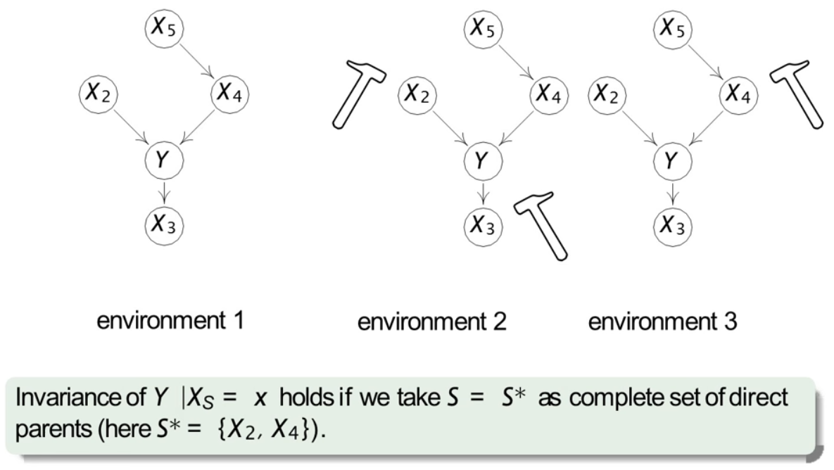
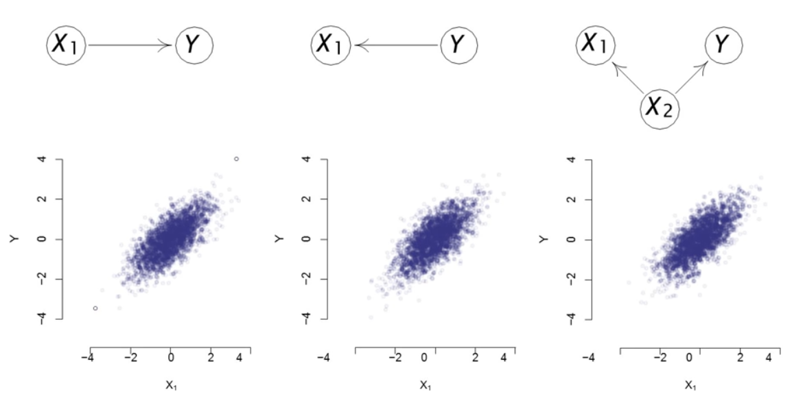
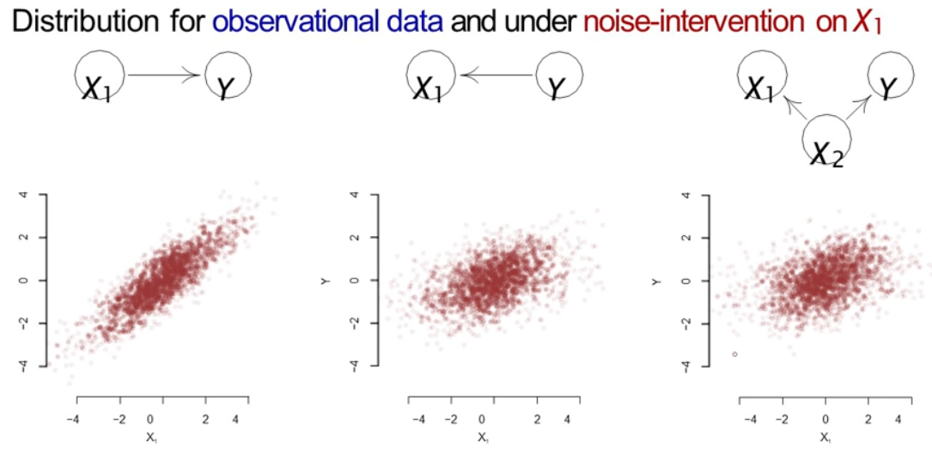
Causal invariance
Principal of Invariant Prediction [Peters, Bühlmann & Meinshausen 2016]
If one knows the values of the causes of an outcome of interest, then it is irrelevant how these values came about.
Modularity, Stability, and Consistency
Causal inference requires that assumptions about invariance to operationalize interventions
While we do not have agree on the set of interventions, we need to theoretically support them.
Interventions can be of at least two types:
noise intervention (perturb a variable) or
do-interventions (set a variable to a certain value).
Different causal models same observational distribution
Sources: [Peters, Bühlmann & Meinshausen 2016] Causal inference by using invariant prediction: identification and confidence intervals. Journal of the Royal Statistical Society. Series B (Statistical Methodology), 947-1012.
Notes:
Principal of Invariant Prediction [Peters, Bühlmann & Meinshausen 2016]
If one knows the values of the causes of an outcome of interest, then it is irrelevant how these values came about, i.e., it makes no difference to the distribution of the outcome of interest.
See also [Arjovsky et al. 2019] Invariant risk minimization. arXiv preprint arXiv:1907.02893.
Causal inference requires that assumptions about invariance to operationalize interventions.
At the same time, we do need to agree on the what intervention is exactly needed. Instead, we should be concerned on it consequences. The challenge to do that is that we typically conflate measurement and interventi
Peters, J., Bühlmann, P., & Meinshausen, N. (2016). Causal inference by using invariant prediction: identification and confidence intervals. Journal of the Royal Statistical Society. Series B (Statistical Methodology), 947-1012.

Slide 47
Causal Discovery with Neural Networks: in presence of latent variables, confounding, and sparsity

Slide 48
Need for Principled Design in Machine Learning
Most machine learning work essentially tries to skip the opening steps, tackling complex problems empirically, without ever trying to build affirm understanding about what initial primitive sare really required for language and higher-level cognition.
Skipping those first steps has not gotten us thus far to language understanding and reliable trustworthy systems that can cope with the unexpected; it is time to reconsider.
Gary Markus (2020), The Next Decade in AI: Four Steps Towards Robust Artificial Intelligence
Notes:
https://www.quora.com/What-is-Yoshua-Bengios-new-Consciousness-Prior-paper-about

Slide 49
Why do we need Causality in Machine Learning?
Context: Correlation-based models make four strong assumptions
Out Of Distribution (OOD)
Covariate Shift and Concept Drift (non-stationarity)
Independent and Identically Distributed (IID) data
Scrambling Training and Testing data
Lack of guidance to intervention (control and exploration)
Credit assignment (explanation, counterfactual thinking)
Search through possible futures is highly intractable
Impact:
Limits systematic generalization
High complexity for adaptation
Yoshua Bengio: From System 1 Deep Learning to System 2 Deep Learning (NeurIPS 2019)
Notes:
Schölkopf, B, et al. (2012). On causal and anticausal learning. arXiv preprint arXiv:1206.6471
Schölkopf, B. (2019). Causality for machine learning. arXiv preprint arXiv:1911.10500.
Parascandolo, G., et al., (2018) Learning Independent Causal Mechanisms, PMLR 80.
Learning theory supports generalization only within same distribution
localized change assumption – Scholkopf 2012
On causal and anticausal learning
Meta-Learning
Right decomposition of knowledge
Meta-randsfer Object for learning to disentangle Causal Mechanisms
Right way to factorize the join-distribution
How to get out of distribution (OOD) transfer/generalization?
Good representations of variables, mechanisms and localized changed hypothesis
OOD generalization as training objective
This depends on good decomposition and knowledge representation
Good OOD performance is a good training signal for factorizing knolwedge

Slide 50
Solutions to generalization shortcomings
Understand how distributions change (simulate non-stationary and dynamic processes)
Composable local representations
Deep nets layers
Factorization of Joint Probabilities
Sparse factor graphs
Alternative assumptions (causal mechanisms) to the I.I.D. assumption
Independence of mechanism principle
Identify knowledge (rules) that can be reused
meta-learning and transfer learning
Temporal Causal Mechanisms
Explanations only for short sequences
Schölkopf, B. (2019). Causality for machine learning. arXiv preprint arXiv:1911.10500.

Slide 51
Causal Inference with Neural Networks
Learning Functional Causal Models with Generative Neural Networks [Goudet et al. 2018]
A meta-transfer objective for learning to disentangle causal mechanisms [Bengio, Y., et al. 2019]
Recurrent Independent Mechanisms [Goyal et al. 2020]
Learning Neural Causal Models from Unknown Interventions [Ke et al. 2020]
Notes:
[Goudet et al. 2018] Goudet, O., Kalainathan, D., Caillou, P., Guyon, I., Lopez-Paz, D., & Sebag, M. (2018). Learning functional causal models with generative neural networks. In Explainable and interpretable models in computer vision and machine learning (pp. 39-80). Springer, Cham.
[Parafita & Vitrià 2020] Parafita, Á., & Vitrià, J. (2020). Causal Inference with Deep Causal Graphs. arXiv preprint arXiv:2006.08380.
[Ke et al. 2020] Ke, N. R., Bilaniuk, O., Goyal, A., Bauer, S., Larochelle, H., Schölkopf, B., ... & Bengio, Y. (2019). Learning neural causal models from unknown interventions. arXiv preprint arXiv:1910.01075.
[Goyal et al. 2020]
[Schoenberg 2020]
[Vallverdu 2020]

Slide 52
My Reading Wishlist on Causality in Neural Nets-1
Out of Distribution Learning
Zhang, Kun, et al. "Domain adaptation as a problem of inference on graphical models." arXiv preprint arXiv:2002.03278 (2020).
Gong, Mingming, et al. "Causal generative domain adaptation networks." arXiv preprint arXiv:1804.04333 (2018).
Ton, Jean-Francois, Dino Sejdinovic, and Kenji Fukumizu. "Meta learning for causal direction." arXiv preprint arXiv:2007.02809 (2020).
Yuan, Ye, Xueying Ding, and Ziv Bar-Joseph. "Causal inference using deep neural networks." arXiv preprint arXiv:2011.12508 (2020).
Jaber et al., Causal Discovery from Soft Interventions with Unknown Targets: Characterization and Learning (2020)
Scalable Models
Kriváchy, Tamás, et al. "A neural network oracle for quantum nonlocality problems in networks." npj Quantum Information 6.1 (2020): 1-7.
Anker, Justin J., et al. "Causal network modeling of the determinants of drinking behavior in comorbid alcohol use and anxiety disorder." Alcoholism: clinical and experimental research 43.1 (2019): 91-97.
Wang, Yuhao, et al. "Causal discovery from incomplete data: a deep learning approach." arXiv preprint arXiv:2001.05343 (2020).
Wu, Pengzhou, and Kenji Fukumizu. "Causal mosaic: Cause-effect inference via nonlinear ica and ensemble method." International Conference on Artificial Intelligence and Statistics. PMLR, 2020.
Pawlowski, Nick, Daniel C. Castro, and Ben Glocker. "Deep structural causal models for tractable counterfactual inference." arXiv preprint arXiv:2006.06485 (2020).
Zhu, Rong, et al. "Efficient and Scalable Structure Learning for Bayesian Networks: Algorithms and Applications." arXiv preprint arXiv:2012.03540 (2020).
Zhang, Yulai, et al. "Parallel ensemble methods for causal direction inference." Journal of Parallel and Distributed Computing (2021).
Amortized Learning of Neural Causal Representations (2020)
Young, et al., Learning Latent Causal Structures with a Redundant Input Neural Network (2020)

Slide 53
My Reading Wishlist on Causality in Neural Nets-2
Dynamical Models
Xie, Xiao, Moqi He, and Yingcai Wu. "CausalFlow: Visual Analytics of Causality in Event Sequences." arXiv preprint arXiv:2008.11899 (2020).
Kurthen, Maximilian, and Torsten Enßlin. "A Bayesian Model for Bivariate Causal Inference." Entropy 22.1 (2020): 46.
Garrido, Sergio, et al. "Estimating Causal Effects with the Neural Autoregressive Density Estimator." arXiv preprint arXiv:2008.07283 (2020).
Wu, Hang, Wang. "An Information Theoretic Learning for Causal Direction Identification." 2020 IEEE 44th Annual Computers, Software, and Applications Conference (COMPSAC). IEEE, 2020.
Inferring Causality in Feedback Systems by Combining Neural Nets and Ordinary Differential Equations [Schoenberg 2020]
Bussmann, et al., Neural Additive Vector Autoregression Models for Causal Discovery in Time Series Data (2020)
Brouillard∗, et al., Differentiable Causal Discovery from Interventional Data (2020)
Epistemology of Causal Deep Learning
Vallverdu, Approximate and Situated Causality in Deep Learning, (2020)
Zenil, et al,, Causal deconvolution by algorithmic generative models. Nat. Mach. Intell (2019)
Zenil, et al., An Algorithmic Information Calculus for Causal Discovery and Reprogramming Systems, iScience. (2019)
Parafita & Vitrià , Causal Inference with Deep Causal Graphs (2020)
Learning Causal Models Online (2020)
An Analysis of the Adaptation Speed of Causal Models (2020)
Systematic evaluation of causal discovery in visual model based reinforcement learning (2021)

Slide 54
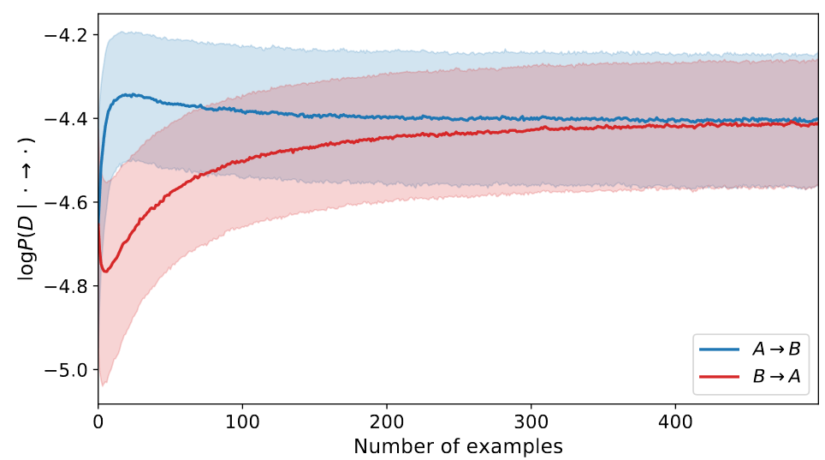
Causal Neural Networks
Causal Generative Neural Networks [Goudet et al. 2017]
CGNNs are causal models of the world that are able to simulate the outcome of interventions to discover v-structures and causal-effect relationships.
Meta-Transfer Objective for Learning to Disentangle Causal Mechanisms [Bengio et al. 2019]
Factorizes a Joint Distribution by using OOD. The learner that has the right factorization will adapt much faster (i.e., require less data). Adapt consists to recover to a change in the distribution.
A causes B or vice versa? How to disentangle (A,B) from observed (X,Y)
Approach: Exploit changes in the distribution AND Speed of adaption
A
B
X
Y
Goudet, O., et al., (2018), Learning Functional Causal Models with Generative Neural Networks .
Bengio, Y., et al. (2019), A meta-transfer objective for learning to disentangle causal mechanisms.
Notes:
Goudet, et al., 2017, Causal Generative Neural Networks

Slide 55
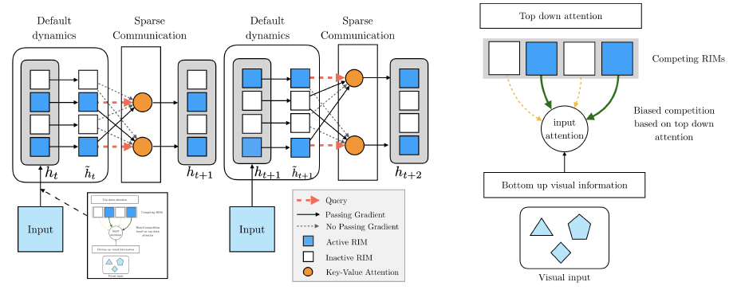
Recurrent Independent Mechanisms [Goyal et al. 2020]
Goal: learn modular structures that (1) reflect the dynamics of the environment and (2) better generalizes, i.e., is more robustness to changes on few of the underlying causes. Approach: Modularize the computation.
source: [Goyal et al. 2020]
first stage, individual RIMs produce a query which is used to read from the current input
second stage, an attention-based competition mechanism is used to select which RIMs to activate (right figure) based on encoded visual input (blue RIMs are active, based on an attention score, white RIMs remain inactive)
third stage, individual activated RIMs follow their own default transition dynamics while non-activated RIMs remain unchanged
fourth stage, the RIMs
sparsely communicate information between themselves, also using key-value attention.

Slide 56
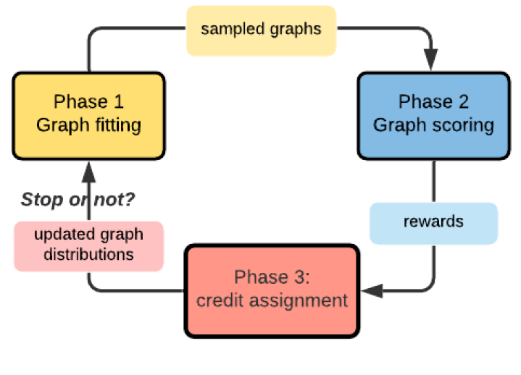
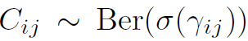
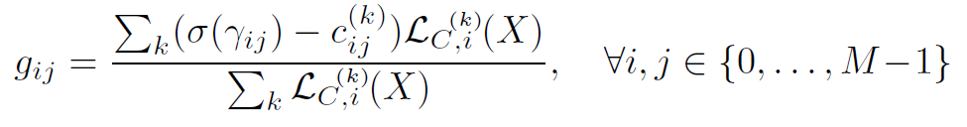
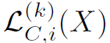
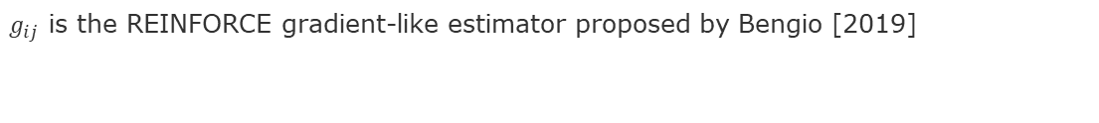
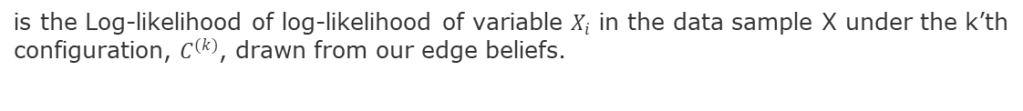
Learning Causal Models from Unknown Interventions [Ke et al. 2019]
Works better than traditional methods
Learning small causal graphs helps avoid exponential
Functional parameters are trained to maximize the likelihood of randomly
drawn observational data under graphs randomly drawn from our current beliefs about the edge structure.
Intervention applied
Intervention predicted
Graphs Sampled and Scored
Intervention retracted
hypothesized
configuration of the SCM’s DAG
$g_{ij}$ is the REINFORCE gradient-like estimator proposed by Bengio [2019]
is the Log-likelihood of log-likelihood of variable $X_{i}$ in the data sample X under the k’th configuration, $C^{(k)}$, drawn from our edge beliefs.
Notes:
A meta-transfer objective for learning to disentangle causal mechanisms. arXiv preprint arXiv:1901.10912, 2019.

Slide 57
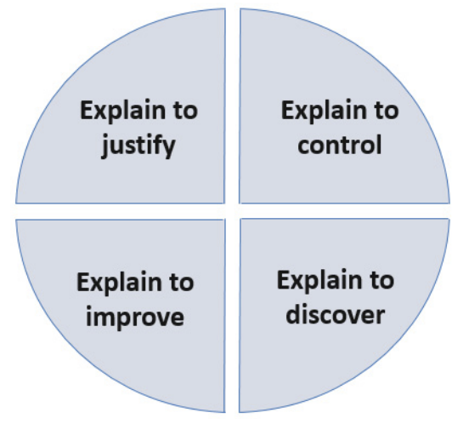
Causal Inference for Explainable Neural Networks: Trust, Fairness, Transfer Learning
Source: [Adadi & Berrada 2018]
Notes:
[Adadi & Berrada 2018] Peeking Inside the Black-Box: A Survey on Explainable Artificial Intelligence (XAI), IEEE Access

Slide 58
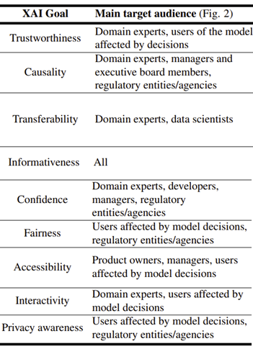

Causality for Explainable AI
eXplainable AI (XAI) are a set of ML techniques to [Arrieta et al 2020]
produce more explainable models while maintaining a high level of learning accuracy
enable humans to understand, trust, and effectively manage the new artificially intelligent partners
source: [Arrieta et al. 2020]
Notes:
[Arrieta et al 2020] Arrieta, A. B., et al. "Explainable Artificial Intelligence (XAI): Concepts, taxonomies, opportunities and challenges toward responsible AI." Information Fusion 58 (2020): 82-115.

Slide 59


Levels of transparency of ML models [Arrieta et al. 2020]
Linear regression
Decision Tree
K-Nearest Neighbor
Rule-Based Learners
Generalized Additive Methods
Bayesian Models

Slide 60


XAI Deep Learning and Summary [Arrieta et al. 2020]
source: [Arrieta et al. 2020] Arrieta, A. B., et al. "Explainable Artificial Intelligence (XAI): Concepts, taxonomies, opportunities and challenges toward responsible AI." Information Fusion 58 (2020): 82-115.

Slide 61
XAI – How? [Arrieta et al. 2020]
XAI in Machine Learning
Post-Hoc Explainability
Transparent
Model-Specific
Model-Agnostic
Explanations by:
Logistic/Linear Regression
Decision Trees
K-NN
Rule-Based Learner
General Additive Methods Bayesian Models
Explanations by:
Ensembles
Multi-layer NN
CNN
RNN
Explanations by:
Simplification
Feature Relevance
Local
Visual
Sensitivity analysis
Saliency
Activations

Slide 62

Pos-hoc Explainability [Arrieta et al. 2020]

Slide 63



XAI in Deep Learning [Arrieta et al. 2020]

Slide 64
Reflection: Beyond accuracy vs explainability trade-off
GNN allowed graphs to be input of Neural Networks
This extended the graph representation from computation to feature engineering
Attention Mechanisms allowed to use the input graph to adapt the computation graph
This extended the memory that a neural network can hold
Causal inference could extend GNN and DL to:
Use graph computation to continuously discover causal structure
Out of Distribution, Inductive learning
Adapt the computation graph online
Invariance learning, Principled Auto-ML
Develop a more principled design approach to deep learning
Pipeline Abstractions, Design Patterns [1,2,3], Frameworks
Key Take-Away Insights
Causality is invariant
Causality allows to exploit correlations safely
Causal structure mitigates for sparsity and supports transfer learning
[1] Zenil, et al., 2019, Causal deconvolution by algorithmic generative models. Nat. Mach. Intell
[2] Zenil, et al., 2019, An Algorithmic Information Calculus for Causal Discovery and Reprogramming Systems, iScience.
[3] Gustafsson, Vallverdu, 2015, The Best Model of a Cat Is Several Cats. Trends Biotechnol.
Notes:
Zenil, H.; Kiani, N.A.; Zea, A.A.; Tegnér, J. Causal deconvolution by algorithmic generative models. Nat. Mach.
Intell. 2019, 1, 58–66. [CrossRef]
Zenil, H.; Kiani, N.A.; Marabita, F.; Deng, Y.; Elias, S.; Schmidt, A.; Ball, G.; Tegnér, J. An Algorithmic
Information Calculus for Causal Discovery and Reprogramming Systems. iScience 2019, 19, 1160–1172.
[CrossRef] [PubMed]
This dynamic nature of causality implies the possibility of defining an object’s properties according to
local variations, that is, in relation to the affordability of such originators for the generation of different
patterns.
Gustafsson, C.; Vallverdú, J. The Best Model of a Cat Is Several Cats. Trends Biotechnol. 2015, 34, 207–213.
[CrossRef] [PubMed]

Slide 65
Next tasks
Please contact me to schedule your final presentations
Continue individual meetings for project update
Level of detail of outcomes to report and discuss
Format of the presentations
Content of the final paper
Final Lecture on Propagation Graph Neural Networks March 17, 5pm.

Slide 66
END

